Slide 1

Department of CSE
COURSE NAME: DBMS
COURSE CODE:24AD2103
Topic:
Joining Relations, Views, Compound Statements and User Defined Functions
Session - 10

Slide 2



AIM OF THE SESSION
To familiarize students how to join the relations in PostgresQL
To aware the students to define views and compound statements
To grasp the students the concept of user defined statements in PostgresQL
INSTRUCTIONAL OBJECTIVES
This Session is designed to get the enough knowledge to join the relations and user defined functions
LEARNING OUTCOMES
At the end of this session, you should be able to write the compound statements

Slide 3
JOINING RELATIONS
Why PostgresQL JOIN:
As the name shows, JOIN means to combine something. In case of SQL, JOIN means "to combine two or more tables".
The PostgresQL JOIN clause takes records from two or more tables in a database and combines it together.
In the process of joining, rows of both tables are combined in a single table.
To access more than one table through a select statement.
ANSI standard PostgresQL defines five types of JOIN :
            1) Inner Join
            2) Left Outer Join
            3) Right Outer Join
            4) Full Outer Join
            5) Cross Join

Slide 4
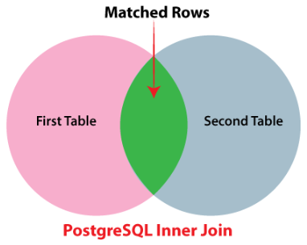
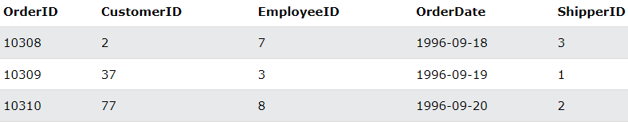
JOINING RELATIONS
1) Inner Join: The INNER JOIN keyword selects records that have matching values in both tables.
Syntax:
        SELECT column_name(s)
        FROM table1
        INNER JOIN table2
        ON table1.column_name = table2.column_name;
Example:
1. Orders table

Slide 5
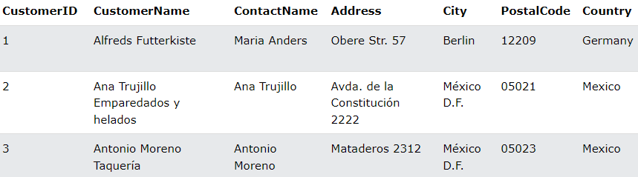
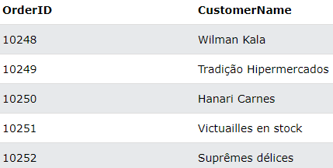
JOINING RELATIONS
2. Customers table
Query:
SELECT Orders.OrderID, Customers.CustomerName
FROM Orders
INNER JOIN Customers ON Orders.CustomerID = Customers.CustomerID;
Output:
Note: Before running the query, insert the records into the tables.

Slide 6
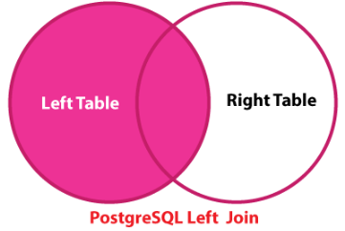
JOINING RELATIONS
2) Left Outer Join: In some databases LEFT OUTER JOIN is called LEFT JOIN. The LEFT JOIN keyword returns all records from the left table (table1), and the matching records from the right table (table2). The result is 0 records from the right side, if there is no match.
Syntax:
        SELECT column_name(s)
        FROM table1
        LEFT JOIN table2
        ON table1.column_name = table2.column_name;

Slide 7
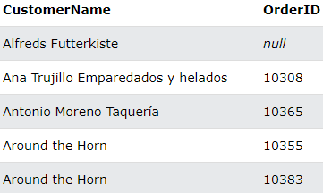
JOINING RELATIONS
Query:
      SELECT Customers.CustomerName, Orders.OrderID
      FROM Customers
      LEFT JOIN Orders ON Customers.CustomerID = Orders.CustomerID
      ORDER BY Customers.CustomerName;
The LEFT JOIN keyword returns all records from the left table (Customers), even if there are no matches in the right table (Orders).
Output:

Slide 8
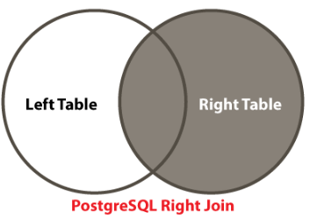
JOINING RELATIONS
3) Right Outer Join: In some databases RIGHT OUTER JOIN is called RIGHT JOIN. The RIGHT JOIN keyword returns all records from the right table (table2), and the matching records from the left table (table1). The result is 0 records from the left side, if there is no match.
Syntax:
      SELECT column_name(s)
      FROM table1
      RIGHT JOIN table2
      ON table1.column_name = table2.column_name;

Slide 9
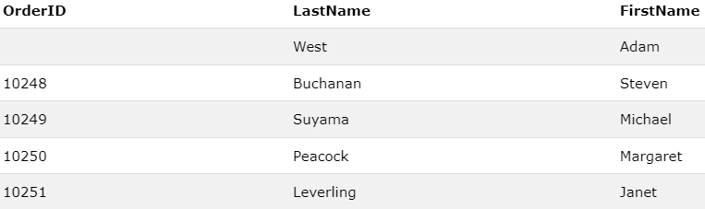
JOINING RELATIONS
Query:
      SELECT Orders.OrderID, Employees.LastName, Employees.FirstName
      FROM Orders
      RIGHT JOIN Employees ON Orders.EmployeeID = Employees.EmployeeID
      ORDER BY Orders.OrderID;
The RIGHT JOIN keyword returns all records from the right table (Employees), even if there are no matches in the left table (Orders).
Output:

Slide 10
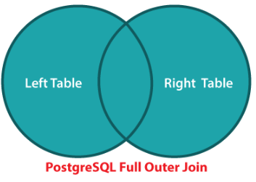
JOINING RELATIONS
4) Full Outer Join: In some databases FULL OUTER JOIN is called FULL JOIN. The FULL OUTER JOIN keyword returns all records when there is a match in left (table1) or right (table2) table records. The FULL OUTER JOIN can potentially return very large result-sets.
Syntax:
        SELECT column_name(s)
        FROM table1
        FULL OUTER JOIN table2
        ON table1.column_name = table2.column_name
        WHERE condition;

Slide 11
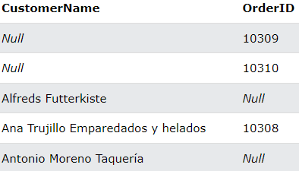
JOINING RELATIONS
Query:
      SELECT Customers.CustomerName, Orders.OrderID
      FROM Customers
      FULL OUTER JOIN Orders ON Customers.CustomerID=Orders.CustomerID
      ORDER BY Customers.CustomerName;
The FULL OUTER JOIN keyword returns all matching records from both tables whether the other table matches or not. So, if there are rows in "Customers" that do not have matches in "Orders", or if there are rows in "Orders" that do not have matches in "Customers", those rows will be listed as well.
Output:

Slide 12
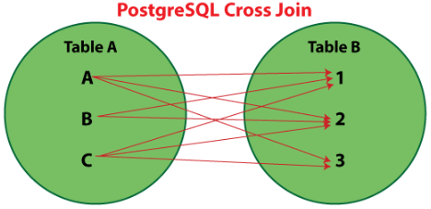
JOINING RELATIONS
5) Cross Join: CROSS JOIN is also known as the Cartesian product / Cartesian join. Cross join defines where the number of rows in the first table multiplied by a number of rows in the second table. Cross Join applies to all columns.
If we add a WHERE clause (if table1 and table2 has a relationship), the CROSS JOIN will produce the same result as the INNER JOIN clause:
Syntax:
    SELECT column_name(s)
    FROM table1
    CROSS JOIN table2;

Slide 13
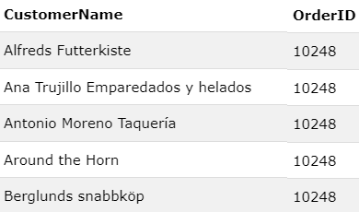
JOINING RELATIONS
Query:
      SELECT Customers.CustomerName, Orders.OrderID
      FROM Customers
      CROSS JOIN Orders;
The CROSS JOIN keyword returns all matching records from both tables whether the other table matches or not. So, if there are rows in "Customers" that do not have matches in "Orders", or if there are rows in "Orders" that do not have matches in "Customers", those rows will be listed as well.
Output:

Slide 14

CREATING AND DROPPING VIEWS
A view can contain all rows of a table or selected rows from one or more tables. A view can be created from one or many tables, which depends on the written PostgreSQL query to create a view.
Views, which are kind of virtual tables, allow users to do the following:
  Structure data in a way that users or classes of users find natural or intuitive.
  Restrict access to the data such that a user can only see limited data instead of complete table.
  Summarize data from various tables, which can be used to generate reports.
Creating Views: The PostgreSQL views are created using the CREATE VIEW statement. The PostgreSQL views can be created from a single table, multiple tables, or another view.
Syntax:

Slide 15
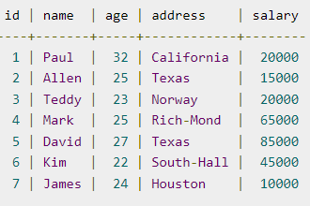


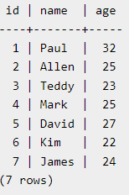
CREATING AND DROPPING VIEWS
Example: Consider, the following COMPANY table is having the following records:
To create a view from COMPANY table. This view would be used to have only few columns from COMPANY table:
We can query COMPANY_VIEW in a similar way as we query an actual table as the following:
Output:
Dropping Views: To drop a view, simply use the DROP VIEW statement with the view_name. The basic DROP VIEW syntax is as follows:

Slide 16
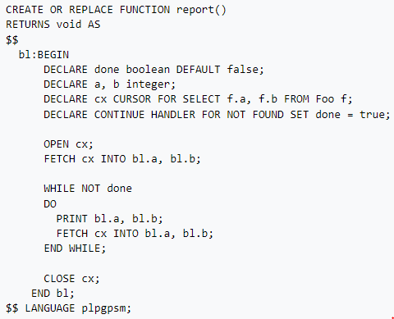
COMPOUND STATEMENTS
Example:
A Compound Statement is in principal the essential block of the SQL/PSM language (PSM --> "Persistent, Stored Modules" allows us to store procedures as database schema elements. PSM = a mixture of conventional statements (if, while, etc.) and SQL). It enables us to enter the sequence of statements, declare local variables, conditions and subroutines, errors (exceptions) and warnings handling. The declaration of variables can not be intersected by the declaration of cursors, errors handling, etc. The variables can be set to the default value. The range of a compound statement is determined by the pair BEGIN END.

Slide 17
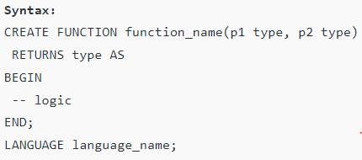
USER DEFINED FUNCTIONS
PostgreSQL uses the CREATE FUNCTION statement to develop user-defined functions.
Details of syntax:
First, specify the name of the function after the CREATE FUNCTION keywords.
Then, put a comma-separated list of parameters inside the parentheses following the function name.
Next, specify the return type of the function after the RETURNS keyword.
After that, place the code inside the BEGIN and END block. The function always ends with a semicolon (;) followed by the END keyword.
Finally, indicate the procedural language of the function e.g., plpgsql in case PL/pgSQL is used.

Slide 18
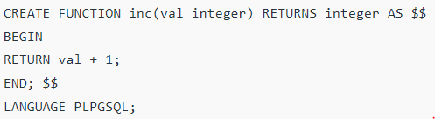



USER DEFINED FUNCTIONS
Example: We will develop a very simple function named inc that increases an integer by 1 and returns the result.
If the function is valid, PostgreSQL will create the function and return the CREATE FUNCTION statement as the following.
Output
We can call the inc function like any built-in functions as follows:
If we call the inc function 2 times (nested), the result is as the following:

Slide 19
ACTIVITIES/ CASE STUDIES/ IMPORTANT FACTS RELATED TO THE SESSION
Create two tables (employee personal and payroll) and execute different types joins.
Create a view for a table student and execute it.
Create a user defined function and execute it.

Slide 20
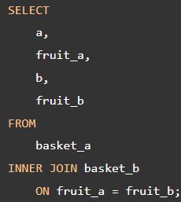
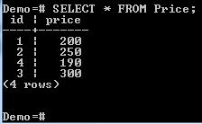

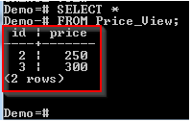

EXAMPLES
1. INNER JOIN: The following statement joins the first table (basket_a) with the second table (basket_b) by matching the values in the fruit_a and fruit_b columns:
2. View: Consider the 'Price' table given below:
Let us create a view from the above table:
The above command will create a view based on the SELECT statement. Only the records where the price is greater than 200 will be added to the view. The view has been given the name Price_View. Let us query it to see its contents:

Slide 21
SUMMARY
The PostgreSQL Joins clause is used to combine records from two or more tables in a database. A JOIN is a means for combining fields from two tables by using values common to each.
A PostgreSQL view is a logical table that represents data of one or more underlying tables through a SELECT statement.
A user defined PostgreSQL function is a group of arbitrary SQL statements designated to perform some task.

Slide 22
SELF-ASSESSMENT QUESTIONS
1. Which join refers to join records from the write table that have no matching key in the left table are include in the result set:
Left Outer Join
Right Outer Join
Full Outer Join
None of the above

Slide 23
SELF-ASSESSMENT QUESTIONS
1. Which join refers to join records from the write table that have no matching key in the left table are include in the result set:
Left Outer Join
Right Outer Join
Full Outer Join
None of the above
Answer: B) Right Outer Join

Slide 24
SELF-ASSESSMENT QUESTIONS
1. Which join refers to join records from the write table that have no matching key in the left table are include in the result set:
Left Outer Join
Right Outer Join
Full Outer Join
None of the above
Answer: B) Right Outer Join
Which view that contains more than one table in the top-level FROM clause of the SELECT statement:
Join View
Datable Join View
Updatable Join View
All of the mentioned

Slide 25
SELF-ASSESSMENT QUESTIONS
1. Which join refers to join records from the write table that have no matching key in the left table are include in the result set:
Left Outer Join
Right Outer Join
Full Outer Join
None of the above
Answer: B) Right Outer Join
Which view that contains more than one table in the top-level FROM clause of the SELECT statement:
Join View
Datable Join View
Updatable Join View
All of the mentioned
Answer: C) Updatable Join View

Slide 26
TERMINAL QUESTIONS
1. Describe types of joins in PostgresQL.
2. How can you a view in PostgresQL?
3. Analyze user defined function with suitable example.

Slide 27
REFERENCES FOR FURTHER LEARNING OF THE SESSION
Reference Books:
1. Database System Concepts, Sixth Edition, Abraham Silberschatz, Yale University Henry, F. Korth Lehigh University, S. Sudarshan Indian Institute of Technology, Bombay.
2. Fundamentals of Database Systems, 7th Edition, RamezElmasri, University of Texas at Arlington, Shamkant B. Navathe, University of Texasat Arlington.
3. An Introduction to Database Systems by Bipin C. Desai
Sites and Web links:
1. https://www.javatpoint.com/sql-tutorial
2. https://www.tutorialspoint.com/sql/index.htm
3. https://www.programiz.com/sql /

Slide 28
THANK YOU
Team – Database Management System

